Slide 1
To establish a Machine Learning model between composition and elastic constants C_{ij} of multi component alloys.
MM 719 – 2021
Presentation Date:15th Nov 2021, 3:30 PM – 4:00 PM
Team ID: 13
Member 1: ROHIT GOYAL
Member 2: PRATEEK KUMAR SINGH
Member 3: KARUSKAR DEVANGKUMAR DHANSUKHBHAI

Slide 2
DATA COLLECTION
The properties extracted from Materials Project Database are:
Density
Poisson’s Ratio
Bulk Modulus
Formation energy
Crystal system
Point group
Elastic tensor
The properties extracted from Pymatgen and Mendeleev are:
Electronegativity
Specific heat
Melting point
Thermal conductivity
Atomic radius

Slide 3
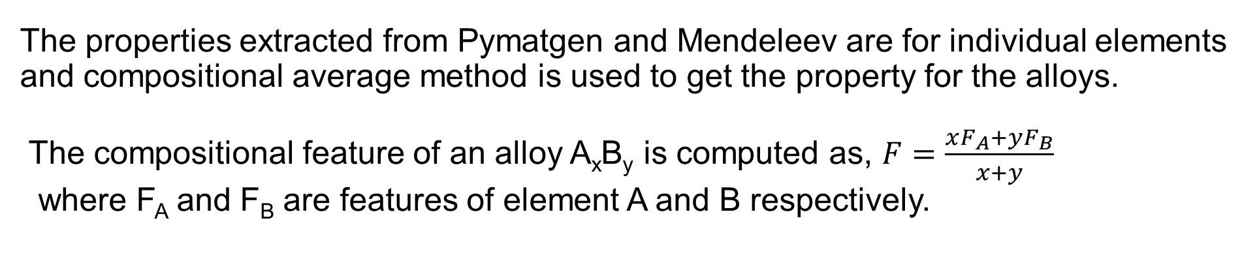
DATA COLLECTION
Criteria:
Only binary alloys.
Thermodynamically stable phases considered, so alloys having the energy above convex hull below 0.01eV/atom were taken.
Only those alloys considered for which the elasticity tensor, bulk modulus, Poisson’s ratio exists.
The properties extracted from Pymatgen and Mendeleev are for individual elements and compositional average method is used to get the property for the alloys.
The compositional feature of an alloy A_{x}B_{y} is computed as, $F=\frac{xF_{A}+yF_{B}}{x+y}$
where F_{A} and F_{B} are features of element A and B respectively.

Slide 4
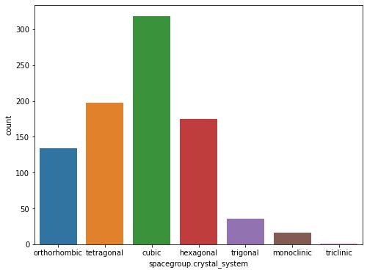
DATA FILTERING
Initially total number of data points were 904 and for each alloy we had 11 features excluding the elasticity tensor.
The alloys for which Poisson’s ratio value is less than 0 or greater than 1 are dropped.
Total seven crystal systems in the data but the count of last three is very less, hence they are dropped.

Slide 5
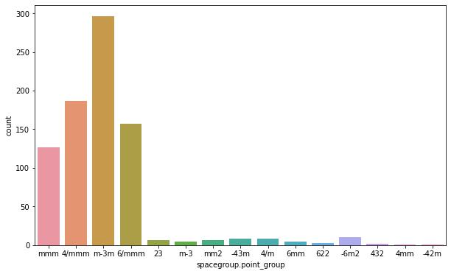
DATA FILTERING
Total fifteen point groups but the count of only first four are significant hence rest are dropped.
The alloys for which elasticity constant values are less than 0 are dropped.
Number of data points left are data filtering is 767.

Slide 6
FEATURE SELECTION
For feature selection multi-collinearity analysis is used.
The variation inflation factor (VIF) serves as a measure of multi-collinearity.
A VIF value much greater than 10 indicates high multi collinearity.
Features | VIF Before feature selection | VIF After feature selection
Density | 34.02 | 14.21
Poisson’s ratio | 22.82 | Dropped
Bulk modulus | 24.34 | 7.54
Melting point | 37.82 | Dropped
Thermal conductivity | 3.88 | 3.09
Radius | 68.81 | 14.41
Electronegativity | 78.82 | Dropped
Specific heat | 2.73 | 2.48
Formation energy | 3.31 | 3.17

Slide 7
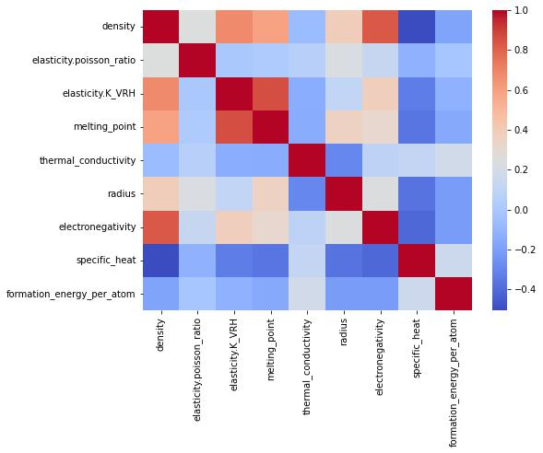
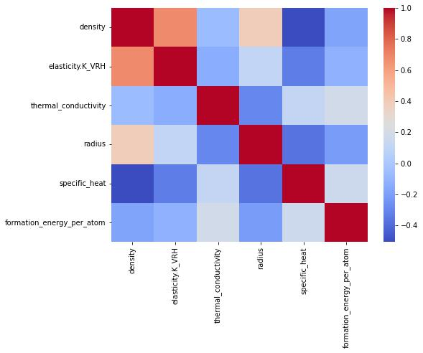
FEATURE SELECTION
(a)
(b)
Pearson’s correlation plot (a) Prior to feature selection (b) After feature selection

Slide 8
MODEL SELECTION
Mean Absolute Error (MAE) | 23.39 GPa
Root Mean Square Error (RMSE) | 35.18 GPa
Explained Variance Score | 0.783
Coefficient of Determination (r²) | 0.782
Randomly selected 70% of the data for model training and rest 30% for testing.
Normalizing the data using MinMaxScaler.
Random Forest Regressor model is used to fit the training data.
We used number of estimators=200 and maximum depth of tree=20.
(a) Without feature selection
Mean Absolute Error (MAE) | 25.85 GPa
Root Mean Square Error (RMSE) | 38.57 GPa
Explained Variance Score | 0.745
Coefficient of Determination (r²) | 0.743
(b) With feature selection

Slide 9
CATEGORICAL FEATURES
Cubic | [1,0,0,0]
Tetragonal | [0,1,0,0]
Hexagonal | [0,0,1,0]
Orthorhombic | [0,0,0,1]
The four crystal systems are represented as shown.
The four point groups are represented as shown
m-3m | [1,0,0,0]
4/mmm | [0,1,0,0]
6/mmm | [0,0,1,0]
mmm | [0,0,0,1]
Further analysing the data we observe that cubic system has point group m-3m and similarly tetragonal, hexagonal and orthorhombic has 4/mmm, 6/mmm and mmm point groups respectively.

Slide 10
Neural Network
Neural network is applied on the data.
Optimizer used such as RMSProp, Adams, Stochastic Gradient Descent.
Mean Absolute Error is computed and plotted.
Activation Function- Relu
Number of Cycle(Epoch) = 20,000
Hidden Layers – 32 and 128.

Slide 11
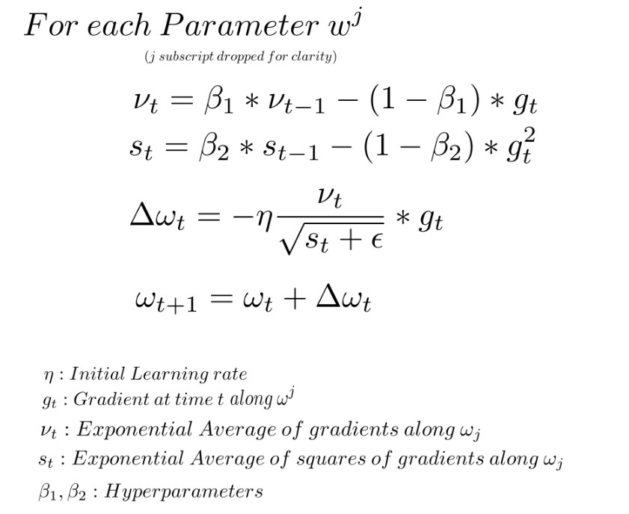
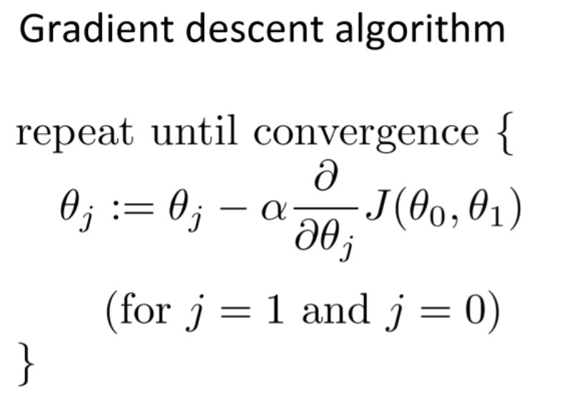
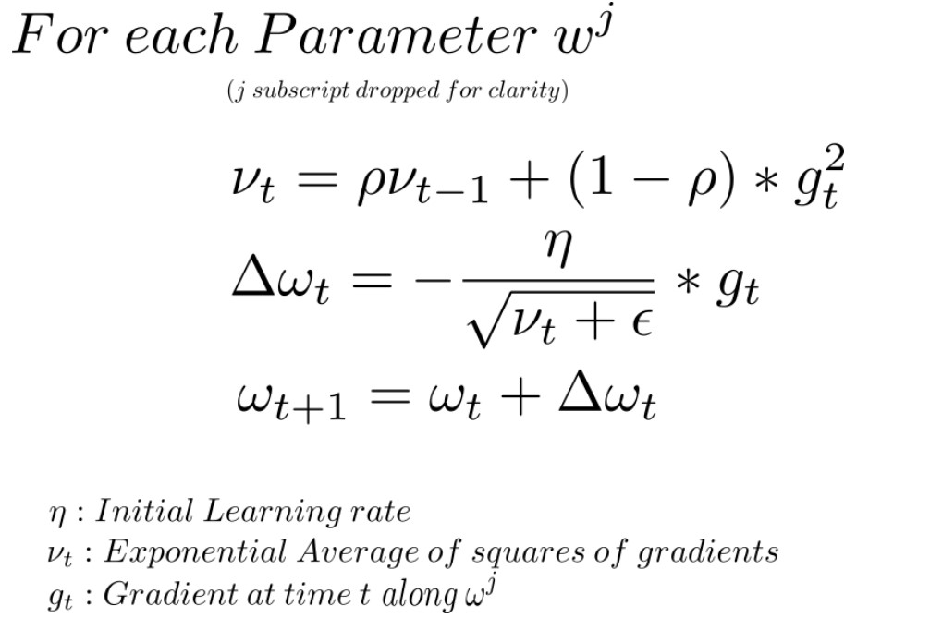
Optimizer Algorithm
Gradient Descent
RMS Prop
Adams

Slide 12
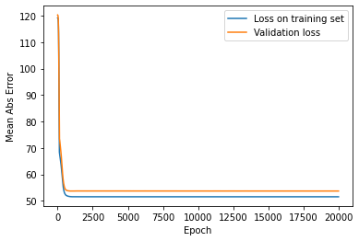
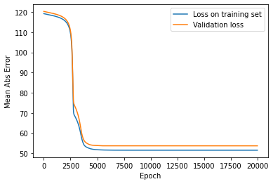
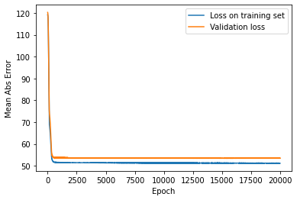
Results
Fig3. RMS Prop
Fig1. Adams
Fig2. SGD

Slide 13
Future Aspects
We will try our models to predicts others properties.
We will go for ternary alloys.
We try our models to predicts properties of some super-alloys like Hastelloy, Inconel, Waspalloy, Rene alloy etc.

Slide 14
Thank you

